Slide 1
Extracting The Main Content Of Web Pages Using The First Impression Area
Presented by Sabarish S (PRN21CS083) Submitted Date:14/10/24
Guided by: Sri. Muhammed Azharudeen Sahib S, Assistant Professor, College of Engineering Perumon
1

Slide 2
Abstract
Proposed Method:
A main content extraction method is introduced, leveraging visual and structural features from the "first impression area" (FIA) of a web page to identify key content areas.
Process:
The method selects high-density content points in the FIA and expands them based on visual and structural conditions.
Evaluation:
Tests on multilingual datasets showed this method outperforms browsers' reader modes and existing methods for both English and non-English pages, with up to 46% improvement in English and 42% in non-English content extraction.
2

Slide 3
Contents:
Introduction
Literature Survey
Existing Method
Proposed Methodology
Experiment
Performance Across Languages
Conclusion
Future Enhancement
Reference
3

Slide 4
Introduction
Main Content Extraction Challenge: Web pages often include irrelevant content (e.g., ads, banners) alongside relevant information, necessitating effective content extraction methods.
Existing Limitations: Many current extraction methods, such as browser reader modes, struggle with non-English web pages, especially languages like Chinese, Japanese, and Korean that don't follow typical English text structures.
Proposed Solution: A language-independent method is introduced, relying on visual and structural HTML features rather than text-based features, making it effective for multilingual pages.
4

Slide 5
Introduction(contd)
Human Visual Perception: The method is based on how humans visually perceive content, starting from the screen center, and identifies the main content in the "first impression area" (FIA) of a web page.
Three-step GCE Method: The approach includes
(1) Grid overlay to define the FIA
(2) Centering on key content areas
(3) Expand DOM which Use visual and structural cues to retrieve content.
Browser-based Implementation: This method has been implemented as a web extension, tested against major browser reader modes and existing methods, and evaluated on multilingual datasets to improve content extraction across languages.
5

Slide 6
Literature Survey
"Automatic content extraction and visualization of Thai websites for improved information representation"(W. Thanadechteemapat and C. C. Fung):
This paper presents an integrated approach for generating Thai-language tag clouds to help users quickly assess website content and mitigate information overload.
‘‘Page-level main content extraction from heterogeneous webpages’’(J. Alarte and J. Silva):
This work presents a real-time DOM-based technique for extracting main content from webpages, including text, images, and animations.
‘‘Effective page segmentation combining pattern analysis and visual separators for browsing on small screens"(P. Xiang, X. Yang and Y. Shi):
This paper introduces an automatic webpage segmentation method using patterns and visual separators
6

Slide 7
Existing Methods
Readability.js (Mozilla Firefox)
A rule-based method that examines HTML elements by tag names, text count, and link density, along with specific rules for well-known websites.
DOM Distiller (Google Chrome)
A hybrid method using Boilerpipe, which classifies text blocks based on shallow text features like word count and HTML structure.
BoilerNet
A deep learning-based method using LSTM, treating text nodes as sequences of text blocks, though it's resource-heavy for web browsers.
7

Slide 8
Existing Methods(contd)
Web2Text
Uses a CNN model with 128 structural and text-based features but struggles with non-English languages due to linguistic dependencies like word count and punctuation.
VIPS
A visual-based approach that segments web pages into blocks using layout, size, and color features, focusing on human visual perception.
8

Slide 9
Proposed Method
Definitions:
Browser Window and Web Document Areas: The browser window is the part of the screen where the web page is displayed, while the web document area is the actual content that the browser renders.
Midpoint: This is the point halfway between the center of the browser window and the center of the web page content.
First Impressions Area (FIA): This is the section of the web page that users see immediately when it loads.
Extraction Band: Located between the browser window center and the web page center, which likely contains the main content.
9

Slide 10
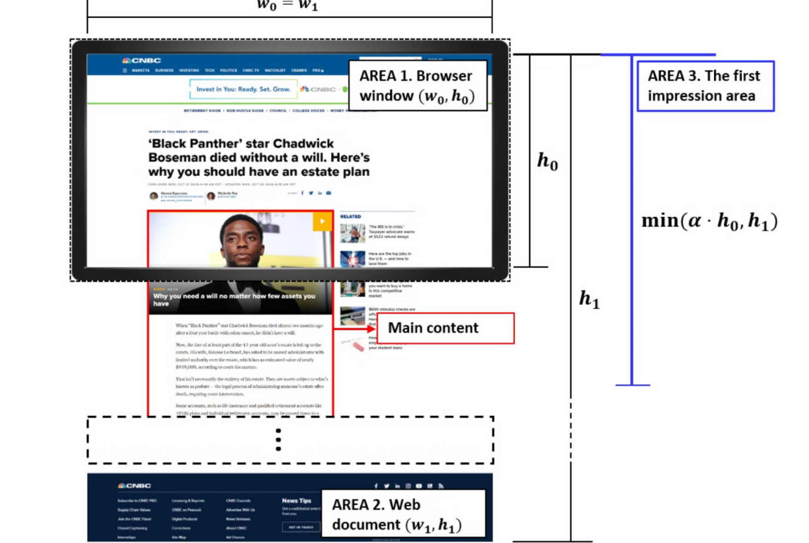
10

Slide 11
Proposed Method(contd)
1) Grid Division:
The webpage is divided into a checkerboard grid based on the browser window size. Example: A 4x6 grid on a 1920x1080 screen gives 320x270 pixel cells.
Calculating Rows (Nrow):
Nrow = ceil(min(α * h0, h1) / hc), where α models user scrolling behavior to optimize the First Impressions Area.
Filtering Irrelevant Cells:
Exclude edge cells, navigation menus, and ads based on link density, calculated as Dl(e) = A1(e) / A(e). Cells with Dl(e) > 0.5 are marked as high-density areas (like ads and menus).
11

Slide 12
2) Centering:
Identify central points likely within the main content area.
Extraction Band:
Centers are found between the browser window center and web document center.
Calculating Centers:
C1 = centroid of all FIA grid centers. C2 = centroid of FIA grid + browser center (Cw). C3 = centroid of FIA grid + browser center (Cw) + document center (Cd). Role of Centers:
Cw reflects user’s initial view, and Cd adjusts for long pages. The closest low-density DOM nodes (E1, E2, E3) to each center are selected as main content points.
12

Slide 13
3) Expanding:
Find a wrapper node around the main content by expanding from leaf nodes (E) toward the .
Too little expansion misses content (low recall). Excessive expansion includes irrelevant content (low precision).
Rules for Main Content Extraction:
Look for tags. Find nodes with “article” or “content” in their attributes. Check width difference with the parent node to identify content wrappers, useful for old or non-English sites.
13

Slide 14
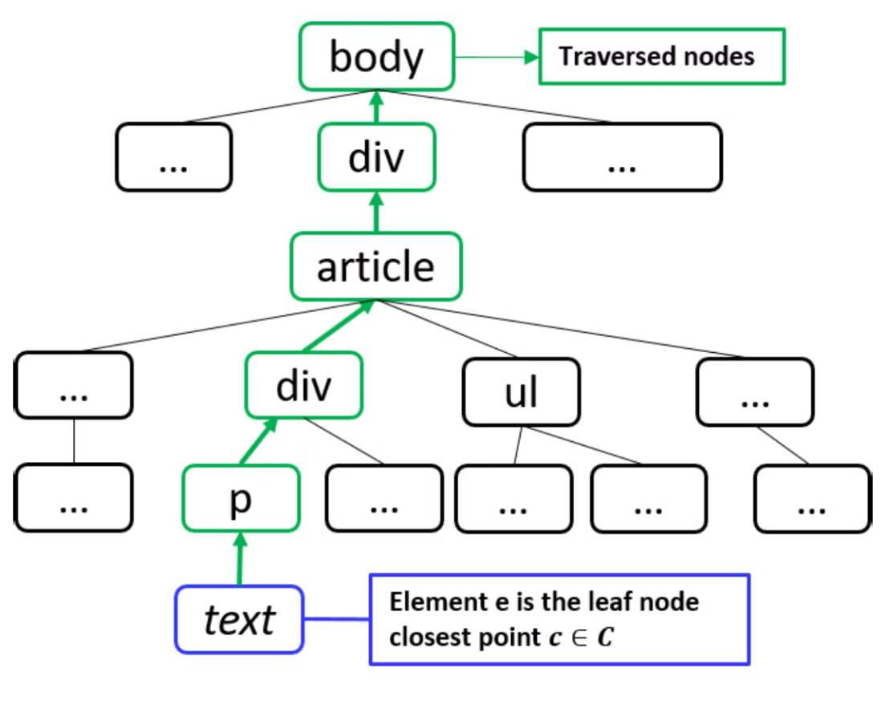
14

Slide 15
Algorithm to find Main Content Candidates
1:E ← E1, E2, E3 F Leaf nodes from each C
2: M ← ∅ 3: for each En in E do
4: N ← En
5: P ← parentNode ( N ) F Parent node of N
6: Mn_tag, Mn_attr, Mn_diff ← ∅ F Each Mn can be set only once in the below while loop
7: while N is not do
8: Mn_tag ← P if P is
9: Mn_attr ← P if ‘‘articleʼʼ or ‘‘contentʼʼ in Pʼs attributes
10: Mn_diff ← P if width(P) > 1w · width(N)
11: Add Mn_tag, Mn_attr, Mn_diff to set M
12: Return M
15

Slide 16
EXPERIMENT
A. Dataset Creation:
Keywords: English from GoogleTrends (2017 & 2020); non-English from GoogleTrends & Baidu.
Collection: Top 100 URLs per keyword, saved as MHTML.
Labeling: Used browser extension to mark "title," "navigation menu," and "main content."
Language Assignment: Annotators labeled in their native language for accuracy.
16

Slide 17
B. Evaluation Settings:
Window Sizes: Tested across multiple browser resolutions.
Grid & Thresholds: Experimented with various grid configurations and expansion thresholds.
Methods Tested: Compared six content extraction methods, such as Readability.js, DOM Distiller, and BoilerNet.
Metrics: Used accuracy measures like Longest Common Subsequence (LCS) and Matched Text Blocks (F1 scores).
17

Slide 18
C. Results Performance Summary:
GCE Performance:
Highest Scores: GCE showed a 30% improvement over Web2Text.
Language Variations:
Japanese: Performed worst due to unique layouts.
Chinese: Scored better thanks to consistent templates.
Method Comparison:
Readability.js: High accuracy but retains extra content.
DOM Distiller: High LCS, low matched text due to merging.
BoilerNet: Language-sensitive, struggles with non-English.
Web2Text: Lowest score, better on non-English with structural features.
18

Slide 19
Performance Across Languages
Method
English
Chinese
Japanese
Readability.js
80%
75%
60%
DOM Distiller
85%
80%
55%
BoilerNet
90%
85%
45%
Proposed Method
95%
90%
70%
The proposed method outperformed existing methods in both English and non-English languages, with up to 46% improvement in English and 42% in non-English content extraction. While most methods struggled with Japanese pages due to unique design and language structure, they performed well on Chinese pages thanks to common templates from Baidu. This suggests that language and design diversity can impact extraction accuracy.
19

Slide 20
CONCLUSION AND DISCUSSION
Performance Across Languages:
While most methods struggled with Japanese pages due to unique design and language structure, they performed well on Chinese pages thanks to common templates from Baidu. This suggests that language and design diversity can impact extraction accuracy.
Principle-Based Method:
Our approach is rooted in universal visual principles rather than language-specific elements. By focusing on the layout and user perception patterns, it achieves effective content extraction across multiple languages.
Adaptive and Scalable:
The rule-based framework allows for easy enhancement by adding new rules or classifiers. This adaptability makes the method scalable and suitable for tailored content extraction in various applications.
20

Slide 21
FUTURE ENHANCEMENT
Designed for desktop, this method could be optimized for mobile environments. Additionally, the concepts here can extend to other applications, making visual-based extraction applicable across different platforms
Instead of using fixed visual and structural conditions for content expansion, you can develop adaptive models that learn from user feedback and interaction to refine the content expansion process. This would allow the model to dynamically adjust to different web page formats and user preferences.
Incorporate personalization based on user preferences or browsing history. The method could prioritize extracting content based on user behavior, focusing on sections that are more relevant to a user’s interests.
21

Slide 22
REFERENCES
Y. Yesilada, ‘‘Web page segmentation: A review,’’ eMINE Tech. Rep. Deliverable 0 (D0), Middle East Tech. Univ. Northern Cyprus Campus, 2011, pp. 1–39.
E. Ferrara, P. De Meo, G. Fiumara, and R. Baumgartner, ‘‘Web data extraction, applications and techniques: A survey,’’ Knowl. Based Syst., vol. 70, pp. 301–323, Nov. 2014.
J. Alarte and J. Silva, ‘‘Page-level main content extraction from heterogeneous webpages,’’ ACM Trans. Knowl. Discovery Data, vol. 15, no. 6, pp. 1–105, Jun. 2021.
P. Xiang, X. Yang, and Y. Shi, ‘‘Effective page segmentation combining pattern analysis and visual separators for browsing on small screens,’’ in Proc. IEEE/WIC/ACM Int. Conf. Web Intell. (WI Main Conf. Proceedings)(WI), Dec. 2006, pp. 831–837.
22

Slide 23
THANK YOU
23

